Slide 1

Personal Finance Savings Predictor
By: Husain Hashemi - 20222727

Slide 2
Objective
Project
Overview
Simplify personal finance management.
Predict savings trends using machine learning.
Key Features
Expense traking.
Income categorization.
Predict future savings.

Slide 3








Technologies Used
Frontend
Backend
HTML, CSS, JavaScript
Chart.js for visualizations
Flask (Python Framework)
Pandas for data manipulation
Scikit-learn for Machine Learning
Libraries
Database/Storage
pandas, numpy, scikit-learn, pickle, matplotlib.
CSV files or databases for storing transaction data.

Slide 4


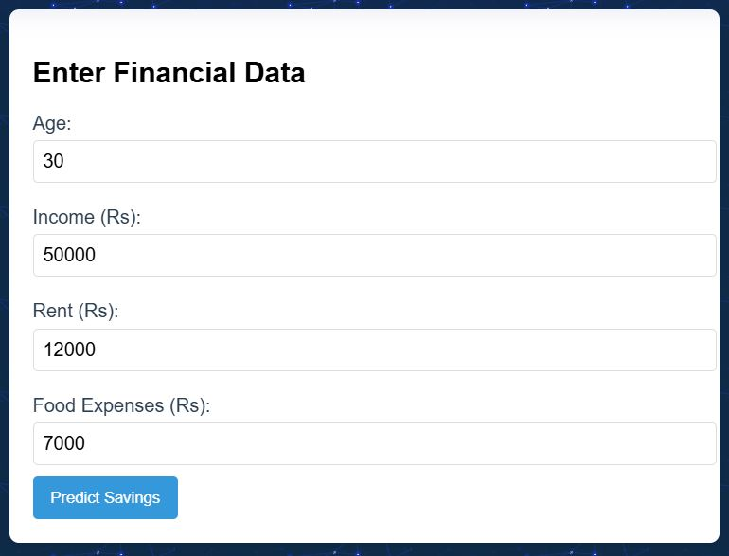
Features
Expense Tracking:
Categorize expenses into Food, Rent, etc.
Savings Prediction:
Predict users’ savings based on their habits.
Visualization:
Simple, user-friendly interface for data input and visualization
Backend API:
Robust RESTful API to handle predictions using a ML Model.

Slide 5
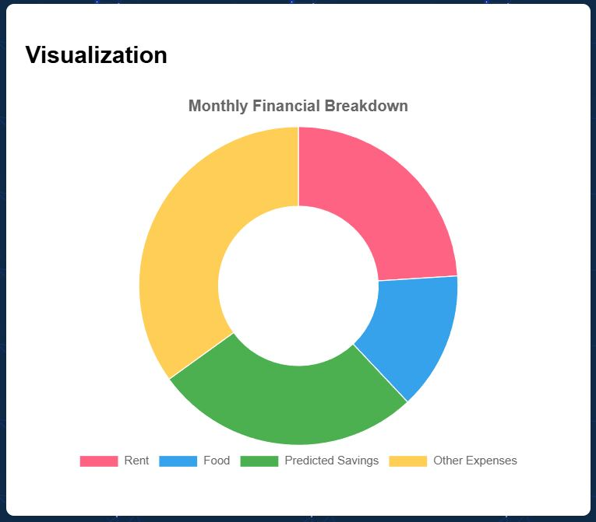
Machine Learning Model
Model Used: Linear Regression
Training Data: Used Train-Test-Split to divide the data and used MSE to evaluate the model’s performance.
Data Visualization: Used matplotlib to draw the graphs of datasets.
Flow Diagram:
Inputs: Age, Income, Rent, Food expenses.
Output: Predicted Savings

Slide 6

Future Plans
Expansion Goals
Additional Features
Time-bound savings predictions for specific goals (e.g., buying a car).
Mobile app integration.
Investments module for stocks and funds.
Bank account synchronization for automated tracking.
Risk analysis for financial decisions.

Slide 7
Conclusions
Our project simplifies financial management and provides actionable insights using technology.
The model’s predictive ability empowers users to achieve their financial goals efficiently.
Call to action:
Interested? Checkout my Github Repository
https://github.com/husainl337/Minor-Project.git
THANK YOU!

